Slide 1
Limited Context Restarting Automata and McNaughton Families Of Languages
Friedrich Otto
Peter Černo, František Mráz

Slide 2
Introduction
Part I: Introduction,
Part II: Clearing and Δ-Clearing Restarting Automata,
Part III: Limited Context Restarting Automata,
Part IV: Confluent Limited Context Restarting Automata,
Part V: Concluding Remarks.

Slide 3
Part I: Introduction
Restarting Automata:
Model for the linguistic technique of analysis by reduction.
Many different types have been defined and studied intensively.
Analysis by Reduction:
Method for checking [non-]correctness of a sentence.
Iterative application of simplifications.
Until the input cannot be simplified anymore.
Restricted Models:
Clearing, Δ-Clearing and Δ*-Clearing Restarting Automata,
Limited Context Restarting Automata.

Slide 4
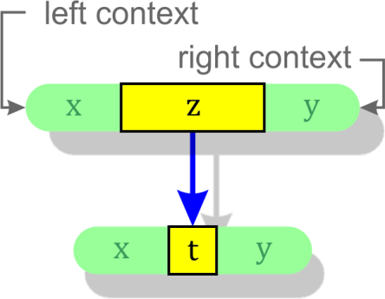
Part II: Clearing Restarting Automata
Let k be a nonnegative integer.
k – context rewriting system (k-CRS )
Is a triple M = (Σ, Γ, I) :
Σ … input alphabet, ¢, $ ∉ Σ,
Γ … working alphabet, Γ ⊇ Σ,
I … finite set of instructions (x, z → t, y) :
x ∊ {¢, λ}.Γ*, |x|≤k (left context)
y ∊ Γ*.{λ, $}, |y|≤k (right context)
z ∊ Γ⁺, z ≠ t ∊ Γ*.
¢ and $ … sentinels.

Slide 5
Rewriting
uzv ⊢_{M} utv iff ∃ (x, z → t, y) ∊ I :
x is a suffix of ¢.u and y is a prefix of v.$ .
L(M) = {w ∊ Σ* | w ⊢*_{M} λ}.
L_{C} (M) = {w ∊ Γ* | w ⊢*_{M} λ}.

Slide 6
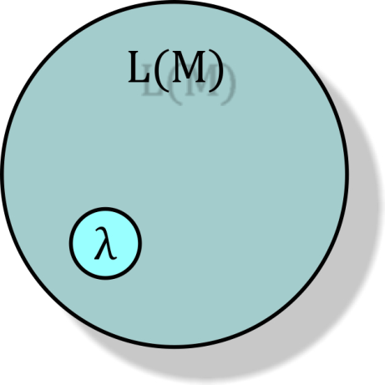
Empty Word
Note: For every k-CRS M: λ ⊢*_{M} λ, hence λ ∊ L(M).
Whenever we say that a k-CRS M recognizes a language L, we always mean that L(M) = L ∪ {λ}.
We simply ignore the empty word in this setting.

Slide 7
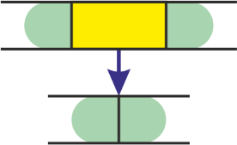
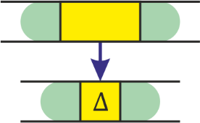
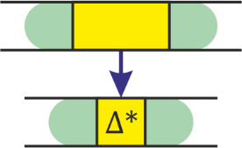
Clearing Restarting Automata
k – Clearing Restarting Automaton (k-cl-RA )
Is a k-CRS M = (Σ, Σ, I) such that:
For each (x, z → t, y) ∊ I : z ∊ Σ⁺, t = λ.
k – Δ – Clearing Restarting Automaton (k-Δ-cl-RA )
Is a k-CRS M = (Σ, Γ, I) such that:
Γ = Σ ∪ {Δ} where Δ is a new symbol, and
For each (x, z → t, y) ∊ I : z ∊ Γ⁺, t ∊ {λ, Δ}.
k – Δ* – Clearing Restarting Automaton (k-Δ*-cl-RA )
Is a k-CRS M = (Σ, Γ, I) such that:
Γ = Σ ∪ {Δ} where Δ is a new symbol, and
For each (x, z → t, y) ∊ I : z ∊ Γ⁺, t = Δ^{i} , 0 ≤ i ≤ |z|.

Slide 8
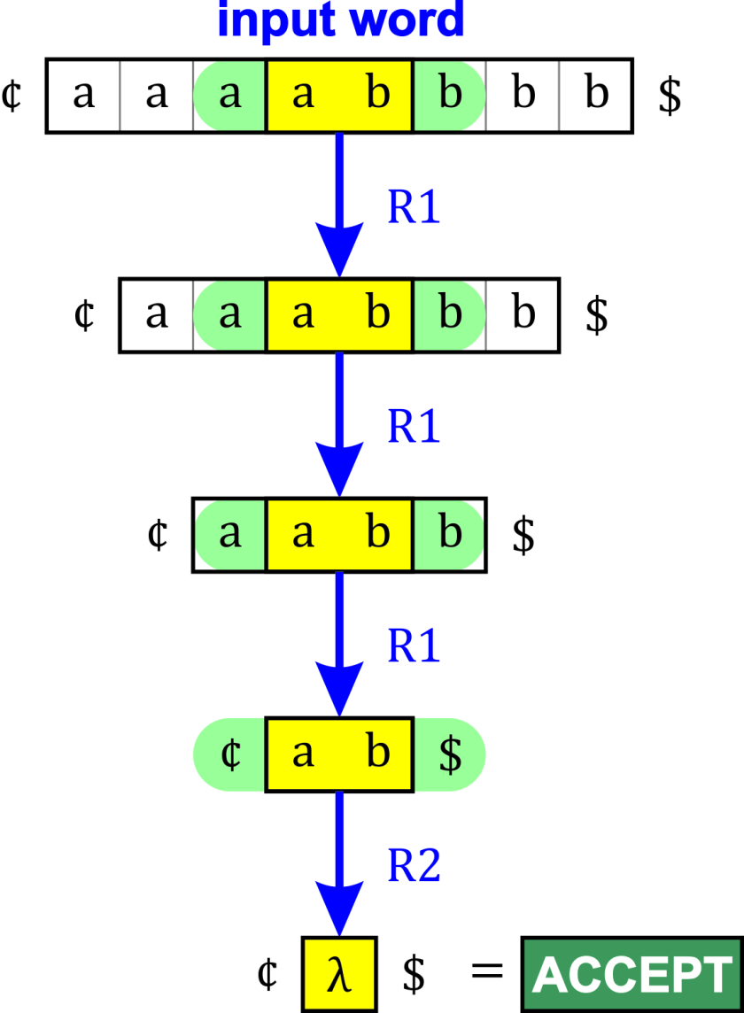
Example 1
L₁ = {a^{n}b^{n} | n > 0} ∪ {λ} :
1-cl-RA M = ({a, b}, I) ,
Instructions I are:
R1 = (a, ab → λ, b) ,
R2 = (¢, ab → λ, $) .
Note:
We did not use Δ.

Slide 9
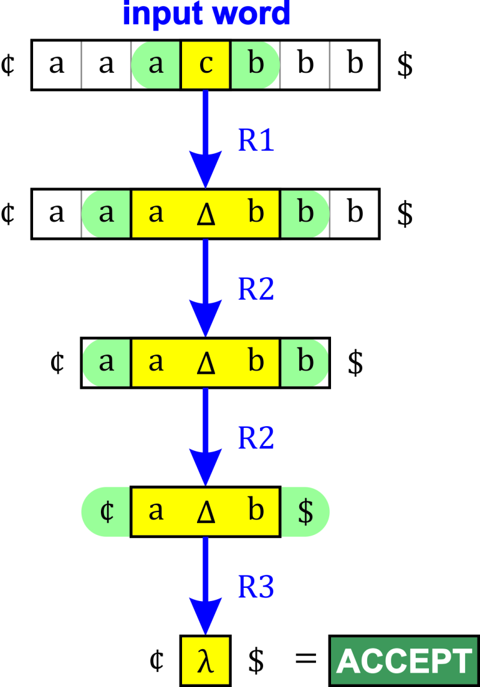
Example 2
L₂ = {a^{n}cb^{n} | n > 0} ∪ {λ} :
1-Δ-cl-RA M = ({a, b, c}, I) ,
Instructions I are:
R1 = (a, c → Δ, b) ,
R2 = (a, aΔb → Δ, b) ,
R3 = (¢, aΔb → λ, $) .
Note:
We must use Δ.

Slide 10
Clearing Restarting Automata
Clearing Restarting Automata:
Accept all regular and even some non-context-free languages.
They do not accept all context-free languages ({a^{n}cb^{n} | n > 0} ).
Δ-Clearing and Δ*-Clearing Restarting Automata:
Accept all context-free languages.
The exact expressive power remains open.
Here we establish an upper bound by showing that Clearing, Δ- and Δ*-Clearing Restarting Automata only accept languages that are growing context-sensitive [Dahlhaus, Warmuth].

Slide 11
Clearing Restarting Automata
Theorem: ℒ(Δ*-cl-RA) ⊆ GCSL.
Proof.
Let M = (Σ, Γ, I) be a k-Δ*-cl-RA for some k ≥ 0.
Let 𝛺 = Γ ∪ {¢, $, Y}, where Y is a new letter.
Let S(M) be the following string-rewriting system over 𝛺 :
S(M) = { xzy → xty | (x, z → t, y) ∊ I } ∪ { ¢$ → Y }.
Let g be a weight function: g(Δ) = 1 and g(a) = 2 for all a ≠ Δ.
Claim: L(M) coincides with the McNaughton language [Beaudry, Holzer, Niemann, Otto] specified by (S(M), ¢, $, Y).
As S(M) is a finite weight-reducing system, it follows that the McNaughton language L(M) is a growing context-sensitive language, that is, L(M) ∊ GCSL. ■

Slide 12
Clearing Restarting Automata

Slide 13
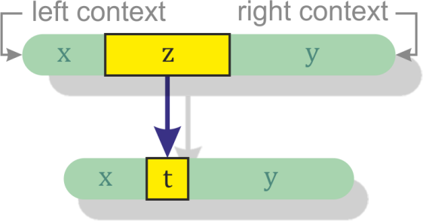
Part III: Limited Context RA
Limited Context Restarting Automaton (lc-RA ):
Is defined exactly as Context Rewriting Systems, except that:
There is no upper bound k on the length of contexts.
The instructions are usually written as: (x | z → t | y).
There is a weight function g such that g(z) > g(t) for all instructions (x | z → t | y) of the automaton.

Slide 14
Limited Context Restarting Automata
Restricted types: lc-RA M = (Σ, Γ, I) is of type:
ℛ₀’ , if I is an arbitrary finite set of (weight-reducing) instructions,
ℛ₁’ , if |t| ≤ 1 ,
ℛ₂’ , if |t| ≤ 1 , x ∊ {¢, λ} , y ∊ {λ, $} ,
ℛ₃’ , if |t| ≤ 1 , x ∊ {¢, λ} , y = $ ,
for all (x | z → t | y) ∊ I .
Moreover, lc-RA M = (Σ, Γ, I) is of type:
ℛ₀ , ( ℛ₁ , ℛ₂ , ℛ₃ , respectively) if it is of type:
ℛ₀’ , ( ℛ₁’ , ℛ₂’ , ℛ₃’ , respectively) and all instructions of M are length-reducing (i.e. |z| > |t| for all (x | z → t | y) ∊ I ).
We use the notation lc-RA[ ℛ_{i}’], lc-RA[ ℛ_{i} ] to denote the corresponding class of the restricted lc-RA s.

Slide 15
lc-RA[ ℛ₀’] and lc-RA[ ℛ₀ ]
Theorem: ℒ(lc-RA[ ℛ₀’]) = ℒ(lc-RA[ ℛ₀ ]) = GCSL.
Proof.
For each lc-RA M = (Σ, Γ, I) we can associate a finite weight-reducing string-rewriting system S(M) such that L(M) is the McNaughton language specified by the four-tuple (S(M), ¢, $, Y).
S(M) = { xzy → xty | (x | z → t | y) ∊ I } ∪ { ¢$ → Y } .
It follows that L(M) ∊ GCSL.
On the other hand, each growing context-sensitive language is accepted by an lc-RA[ ℛ₀ ]. ■

Slide 16
lc-RA[ ℛ₁’]
Theorem: ℒ(lc-RA[ ℛ₁’]) = GCSL.
Proof.
Let G = (N, T, S, P) be a weight-increasing context-sensitive grammar. By taking:
I(G) = { (u | x → A | v) | (uAv → uxv) ∊ P } ∪
{ (¢ | r → λ | $) | (S → r) ∊ P },
we obtain an lc-RA[ ℛ₁’] M(G) = ( T, N ∪ T, I(G) ) such that
L(M(G)) = L(G) ∪ {λ} .
The class of languages generated by weight-increasing context-sensitive grammars, which is known as the class ACSL (acyclic context-sensitive languages), coincides with the class GCSL [Niemann, Woinowski].
Thus, ℒ(lc-RA[ ℛ₁’]) ⊇ GCSL. ■

Slide 17
lc-RA[ ℛ₁ ]
Theorem: ℒ(lc-RA[ ℛ₁]) = GACSL.
Proof.
Let lc-RA M = (Σ, Γ, I) be of type ℛ₁ .
For all (x | z → t | y) ∊ I : |z| > |t| and |t| ≤ 1 .
Lemma: It is possible to obtain an equivalent lc-RA M such that:
For all (x | z → t | y) ∊ I : |z| > |t| and |t| = 1 if x ≠ ¢ or y ≠ $ .
From string-rewriting system: R = { xty → xzy | (x | z → t | y) ∊ I } ,
We construct a length-increasing context-sensitive grammar :
G = (Γ, Σ, S, R) such that L(G) = ¢ . L(M) . $ .
The class of languages generated by length-increasing context-sensitive grammars is known as the class GACSL ( growing acyclic context-sensitive languages). GACSL ⊆ ACSL = GCSL .
¢ . L(M) . $ ∊ GACSL , i.e. L(M) ∊ GACSL [Buntrock]. Similarly ⊇ . ■

Slide 18
lc-RA[ ℛ₂’] and lc-RA[ ℛ₂ ]
Theorem: ℒ(lc-RA[ ℛ₂’]) = ℒ(lc-RA[ ℛ₂ ]) = CFL.
Proof.
Let lc-RA M = (Σ, Γ, I) be of type ℛ₂’ .
For all (x | z → t | y) ∊ I : |t| ≤ 1 , x ∊ {¢, λ} , y ∊ {λ, $} .
We split R(M) = { xzy → xty | (x | z → t | y) ∊ I } into 4 subsystems:
Take
Then A(M) is a finite set. Let . Then L(M) =

Slide 19
lc-RA[ ℛ₂’] and lc-RA[ ℛ₂ ]
Proof. (Continued).
Consider a mixed rewriting system:
Prefix-rewriting system:
Suffix-rewriting system:
String-rewriting system:
The rules of a prefix-rewriting system (suffix-rewriting system) are only applied to the prefix (suffix) of a word.
Apparently:
As P(M) only contains generalized monadic rules, it follows that the language L(M) is context-free [Leupold, Otto].
Moreover, it is easy to obtain from a given context-free grammar an equivalent lc-RA M = (Σ, Γ, I) of the type ℛ₂ .
Thus we have: CFL ⊆ ℒ(lc-RA[ ℛ₂ ]) ⊆ ℒ(lc-RA[ℛ₂’]) ⊆ CFL . ■

Slide 20
lc-RA[ ℛ₃’] and lc-RA[ ℛ₃ ]
Theorem: ℒ(lc-RA[ ℛ₃’]) = ℒ(lc-RA[ ℛ₃ ]) = REG.
Proof.
Let lc-RA M = (Σ, Γ, I) be of type ℛ₃’ .
For all (x | z → t | y) ∊ I : |t| ≤ 1 , x ∊ {¢, λ} , y = $ .
We split R(M) = { xzy → xty | (x | z → t | y) ∊ I } into 2 subsystems:
Now we take only the suffix-rewriting system P(M) = P_{suf} , where:
P_{suf} =
Apparently: is regular.
Again, it is easy to obtain from a given regular grammar an equivalent lc-RA M = (Σ, Γ, I) of the type ℛ₃ .
Thus we have: REG ⊆ ℒ(lc-RA[ ℛ₃ ]) ⊆ ℒ(lc-RA[ℛ₃’]) ⊆ REG . ■

Slide 21
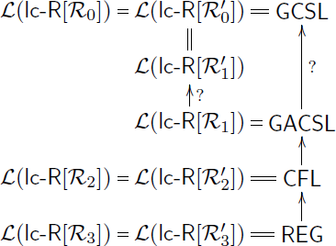
Limited Context Restarting Automata
Hierarchy of Language Classes:

Slide 22
Part IV: Confluent lc-RA
Since lc-RA M is a nondeterministic device, it is difficult to decide the membership in L(M).
Here we are interested in lc-RA M = (Σ, Γ, I) for which all computations from ¢ w $ lead to ¢ $ , if w ∊ L(M).
The reduction relation ⊢_{M} corresponds to the single-step reduction relation ⇒_{R(M)} induced by the string-rewriting system R(M) = { xzy → xty | (x | z → t | y) ∊ I } on ¢ Γ* $.
As it is undecideable whether R(M) is confluent on the congruence class [¢ $]_{R(M)} , we consider only confluence.
An lc-RA M = (Σ, Γ, I) is called confluent if the corresponding string-rewriting system R(M) is confluent.
We use the prefix con- to denote confluent lc-RA.

Slide 23
lc-RA[ con-ℛ₀’] and lc-RA[ con-ℛ₀ ]
Theorem: ℒ(lc-RA[ con-ℛ₀’]) = ℒ(lc-RA[ con-ℛ₀ ]) = CRL.
Proof.
For each lc-RA[ con-ℛ₀’] M = (Σ, Γ, I) : S(M) = R(M)∪ { ¢$ → Y } is a finite weight-reducing string-rewriting system that is confluent.
L(M) is the McNaughton language specified by (S(M), ¢, $, Y), i.e.
L(M) is a Church-Rosser language [McNaughton, Narendran, Otto].
On the other hand, each Church-Rosser language L is accepted by a length-reducing deterministic two-pushdown automaton A [Niemann, Otto].
Based on A it is possible to construct a confluent lc-RA of type ℛ₀ recognizing the language L. ■

Slide 24
lc-RA[ con-ℛ₃’] and lc-RA[ con-ℛ₃ ]
Theorem: ℒ(lc-RA[ con-ℛ₃’]) = ℒ(lc-RA[ con-ℛ₃ ]) = REG.
Proof.
Apparently, ℒ(lc-RA[ con-ℛ₃’]) ⊆ ℒ(lc-RA[ ℛ₃’]) = REG.
Conversely, if L ⊆ Σ* is regular then there exists DFA A = (Q, Σ, q₀ , F, δ) that accepts L^{R}. We define lc-RA M = (Σ , Σ ∪ Q , I), where I =
It is easy to see that L(M) = L^{R}, and that the string-rewriting system R(M) is confluent. By taking M’ = (Σ , Σ ∪ Q , I’), where:
We obtain a confluent lc-RA of type ℛ₃ that accepts L. ■

Slide 25
lc-RA[ con-ℛ₂’] and lc-RA[ con-ℛ₂ ]
For other classes we have no characterization results.
We have only some preliminary results.
Lemma: ℒ(lc-RA[ con-ℛ₂’]) ⊆ DCFL ∩ DCFL^{R}.
Proof Idea.
Consider the leftmost derivation, which can be realized by a deterministic pushdown automaton. ■
Lemma: The deterministic context-free language
Is not accepted by any lc-RA[ con-ℛ₂’].
Note: Both L_{u} and L_{u}^{R} are DLIN languages.
Corollary: ℒ(lc-RA[ con-ℛ₂’]) ⊂ DCFL ∩ DCFL^{R}.

Slide 26
lc-RA[ con-ℛ₂’] and lc-RA[ con-ℛ₂ ]
Lemma: The nonlinear language { a^{n}b^{n} c^{m}d^{m} | n, m ≥ 1 } is accepted by a confluent lc-RA of type ℛ₂ .
Corollary: The class of languages accepted by confluent lc-RA of type ℛ₂’ is incomparable to DLIN and LIN.
These results also hold for the class of languages that are accepted by lc-RA[ con-ℛ₂ ].
The exact relationship of these classes of languages to the class of confluent [generalized] monadic McNaughton languages [Leupold, Otto] remains open.

Slide 27
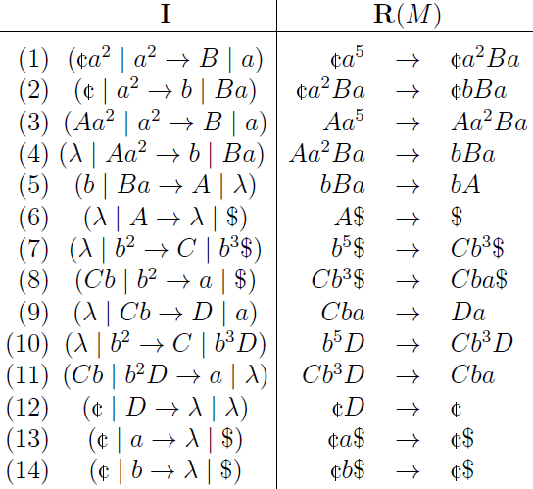
lc-RA[ con-ℛ₁’] and lc-RA[ con-ℛ₁ ]
Lemma: The language L_{expo5} = { a ^{5 n} | n ≥ 0 } is accepted by an lc-RA[ con-ℛ₁ ].
Proof. Take Σ = {a}, Γ = {a, b, A, B, C, D}, and M = (Σ, Γ, I), where I :

Slide 28
lc-RA[ con-ℛ₁’] and lc-RA[ con-ℛ₁ ]
As the language L_{expo5} is not context-free, we obtain:
Corollary: The class of languages accepted by confluent lc-RA of type ℛ₁ is incomparable to CFL.
In particular, lc-RA[ con-ℛ₁ ] ⊃ lc-RA[ con-ℛ₂ ].
These results also hold for the class of languages that are accepted by lc-RA[ con-ℛ₁’].

Slide 29
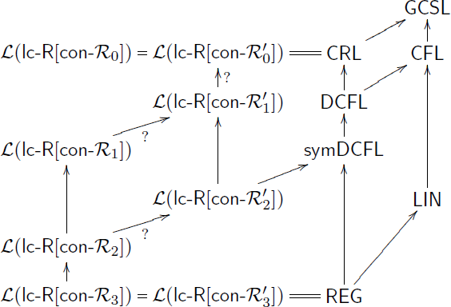
Confluent lc-RA
Hierarchy of Language Classes:

Slide 30
Part V: Concluding Remarks
The class GCSL forms an upper bound for all types of limited context restarting automata considered.
Under the additional requirement of confluence, the Church-Rosser languages form an upper bound.
For the most restricted types of lc-RA we obtain regular languages, both in confluent and non-confluent case.
For the intermediate systems, the question for an exact characterization of the corresponding classes of languages remains open.
For the intermediate systems it even remains open whether the weight-reducing lc-RA are more expressive than the corresponding length reducing lc-RA.

Slide 31
References
BASOVNÍK, Learning restricted restarting automata using genetic algorithm.
Master's thesis, Charles University, MFF, Prague, 2010.
BASOVNÍK, MRÁZ, Learning limited context restarting automata by genetic algorithms.
In: J. DASSOW, B. TRUTHE (eds.), Theorietag 2011. Otto-von-Guericke-Universität, Magdeburg, 2011, 1-4.
BEAUDRY, HOLZER, NIEMANN, OTTO, McNaughton families of languages.
Theoret. Comput. Sci. 290 (2003), 1581-1628.
BOOK, OTTO, String-Rewriting Systems. Springer, New York, 1993.
BÜCHI, Regular canonical systems.
Arch. f. Math. Logik Grundlagenf. 6 (1964), 91-111.
G. BUNTROCK, Wachsende kontext-sensitive Sprachen.
Habilitationsschrift, Fakultät für Mathematik und Informatik, Universität at Würzburg, 1996.
BUNTROCK, OTTO, Growing context-sensitive languages and Church-Rosser languages.
Inform. and Comput. 141 (1998), 1-36.
ČERNO, MRÁZ, Clearing restarting automata. Fund. Inf. 104 (2010), 17-54.
ČERNO, MRÁZ, Δ-clearing restarting automata and CFL.
In: G. MAURI, A. LEPORATI (eds.), DLT 2011. LNCS 6795, Springer, Berlin, 2011, 153-164.
DAHLHAUS, WARMUTH, Membership for growing context-sensitive grammars is polynomial.
J. Comput. System Sci. 33 (1986), 456-472.
HOFBAUER, WALDMANN, Deleting string rewriting systems preserve regularity.
Theoret. Comput. Sci. 327 (2004), 301-317.
JANČAR, MRÁZ, PLÁTEK, VÖGEL, Restarting automata.
In: H. REICHEL (ed.), FCT'95. LNCS 965, Springer, Berlin, 1995, 283-292.
LEUPOLD, OTTO, On McNaughton families of languages that are specified by some variants of monadic string-rewriting systems. Fund. Inf. 112 (2011), 219-238.
MCNAUGHTON, NARENDRAN, OTTO, Church-Rosser Thue systems and formal languages.
J. Assoc. Comput. Mach. 35 (1988), 324-344.
NIEMANN, OTTO, The Church-Rosser languages are the deterministic variants of the growing context-sensitive languages.
Inform. and Comput. 197 (2005), 1-21.
NIEMANN, WOINOWSKI, The growing context-sensitive languages are the acyclic context-sensitive languages.
In: W. KUICH, G. ROZENBERG, A. SALOMAA (eds.), DLT 2002 . LNCS 2295, Springer, Berlin, 2002, 197-205.
OTTO, On deciding the congruence of a finite string-rewriting system on a given congruence class.
J. Comput. System Sci. 35 (1987), 285-310.
OTTO, Restarting automata.
In: Z. ÉSIK, C. MARTIN-VIDE, V. MITRANA (eds.), Recent Advances in Formal Languages and Applications. Studies in Computational Intelligence 25, Springer, Berlin, 2006, 269-303.

Slide 32
Thank You!
This presentation is available on the following website:
http://popelka.ms.mff.cuni.cz/cerno/files/otto_cerno_mraz_lcra_presentation.pdf

