Slide 1
Clearing Restarting Automata and Grammatical Inference
Peter Černo
Department of Computer Science
Charles University in Prague, Faculty of Mathematics and Physics

Slide 2
Table of Contents
Part I: Introduction,
Part II: Learning Schema,
Part III: Active Learning Example,
Part IV: Hardness Results,
Part V: Concluding Remarks.

Slide 3
Part I: Introduction
Restarting Automata:
Model for the linguistic technique of analysis by reduction.
Many different types have been defined and studied intensively.
Analysis by Reduction:
Method for checking [non-]correctness of a sentence.
Iterative application of simplifications.
Until the input cannot be simplified anymore.
Restricted Models:
Clearing, Δ-Clearing and Δ*-Clearing Restarting Automata,
Subword-Clearing Restarting Automata.
Our method is similar to the delimited string-rewriting systems [Eyraud et al. (2007)].

Slide 4
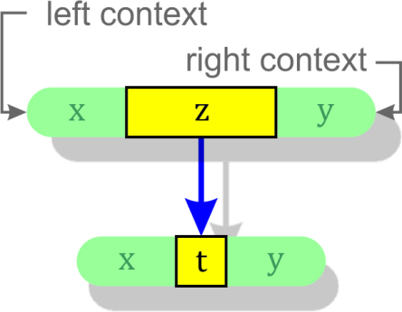
Context Rewriting Systems
Let k be a nonnegative integer.
k – Context Rewriting System (k-CRS )
Is a triple M = (Σ, Γ, I) :
Σ … input alphabet, ¢, $ ∉ Σ,
Γ … working alphabet, Γ ⊇ Σ,
I … finite set of instructions (x, z → t, y) :
x ∊ Γ ^{k} ∪ {¢}.Γ ^{≤ k - 1} (left context)
y ∊ Γ ^{k} ∪ Γ ^{≤ k - 1}.{$} (right context)
z ∊ Γ⁺, z ≠ t ∊ Γ*.
¢ and $ … sentinels.
The width of instruction i = (x, z → t, y) is |i| = |xzty| .
In case k = 0 we use x = y = λ .

Slide 5
Rewriting
uzv ⊢_{M} utv iff ∃ (x, z → t, y) ∊ I :
x is a suffix of ¢.u and y is a prefix of v.$ .
L(M) = {w ∊ Σ* | w ⊢*_{M} λ}.
L_{C} (M) = {w ∊ Γ* | w ⊢*_{M} λ}.

Slide 6
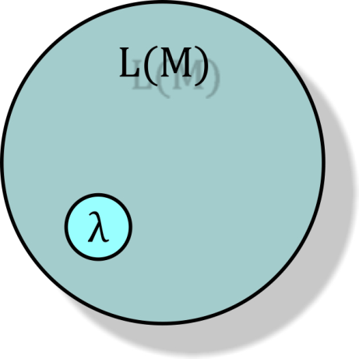
Empty Word
Note: For every k-CRS M: λ ⊢*_{M} λ, hence λ ∊ L(M).
Whenever we say that a k-CRS M recognizes a language L, we always mean that L(M) = L ∪ {λ}.
We simply ignore the empty word in this setting.

Slide 7
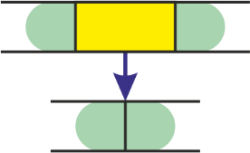
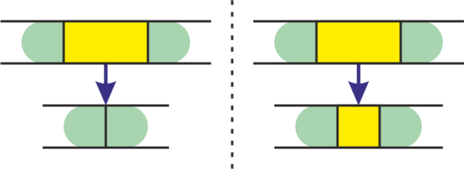
Clearing Restarting Automata
k – Clearing Restarting Automaton (k-cl-RA )
Is a k-CRS M = (Σ, Σ, I) such that:
For each (x, z → t, y) ∊ I : z ∊ Σ⁺, t = λ.
k – Subword-Clearing Rest. Automaton (k-scl-RA )
Is a k-CRS M = (Σ, Σ, I) such that:
For each (x, z → t, y) ∊ I :
z ∊ Γ⁺, t is a proper subword of z.

Slide 8
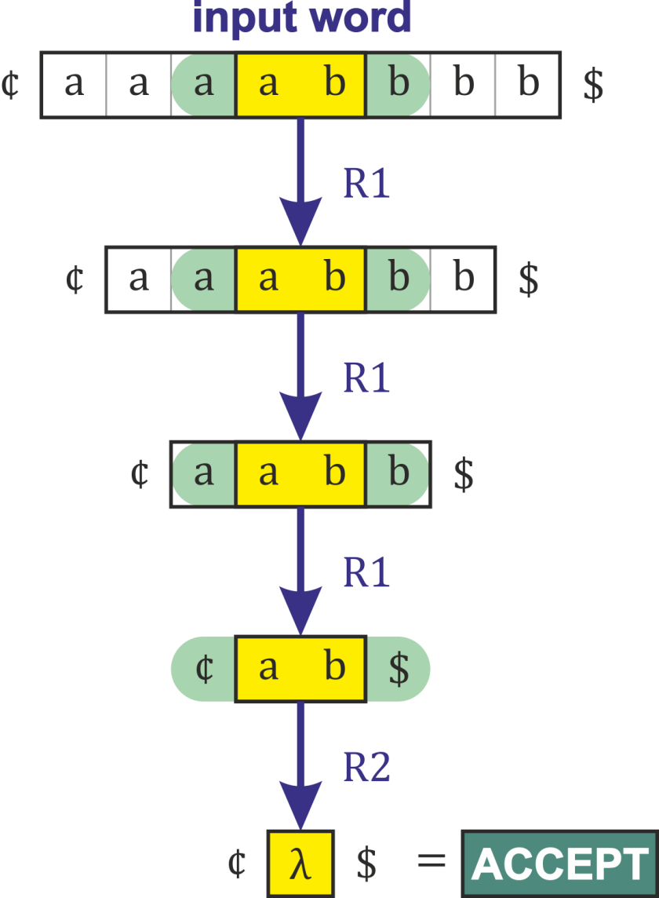
Example 1
L₁ = {a^{n}b^{n} | n > 0} ∪ {λ} :
1-cl-RA M = ({a, b}, I) ,
Instructions I are:
R1 = (a, ab → λ, b) ,
R2 = (¢, ab → λ, $) .

Slide 9
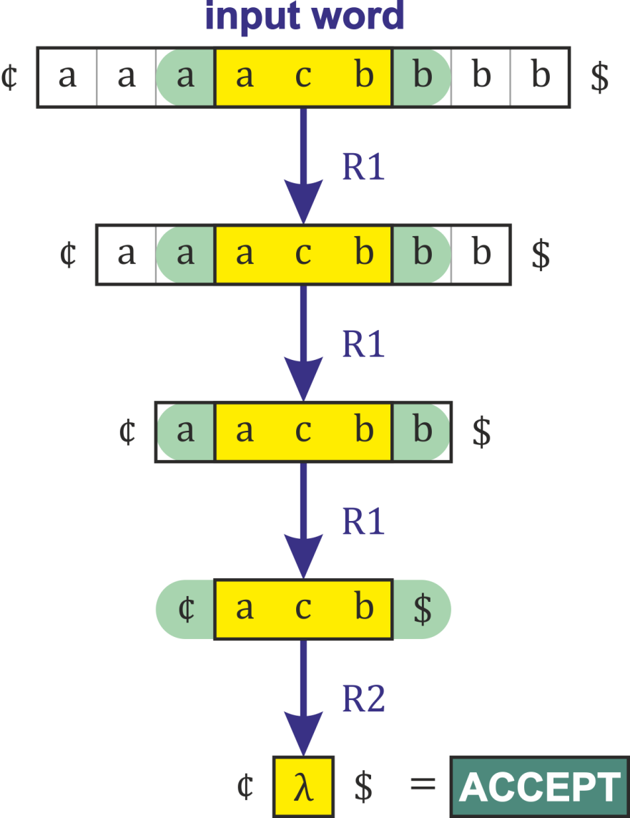
Example 2
L₂ = {a^{n}cb^{n} | n > 0} ∪ {λ} :
1-scl-RA M = ({a, b, c}, I) ,
Instructions I are:
R1 = (a, acb → c, b) ,
R2 = (¢, acb → λ, $) .
Note:
The language L₂ cannot
be recognized by any cl-RA.

Slide 10
Clearing Restarting Automata
Clearing Restarting Automata:
Accept all regular and even some non-context-free languages.
They do not accept all context-free languages ({a^{n}cb^{n} | n > 0} ).
Subword-Clearing Restarting Automata:
Are strictly more powerful than Clearing Restarting Automata.
They do not accept all context-free languages ({w w^{R} | w ∊ Σ*} ).
Upper bound:
Subword-Clearing Restarting Automata only accept languages that are growing context-sensitive [Dahlhaus, Warmuth].

Slide 11
Hierarchy of Language Classes

Slide 12
Part II: Learning Schema
Goal: Identify any hidden target automaton in the limit from positive and negative samples.
Input:
Set of positive samples S⁺,
Set of negative samples S⁻,
We assume that S⁺∩ S⁻ = ⍉, and λ ∊ S⁺.
Output:
Automaton M such that: L(M) ⊆ S⁺ and L(M) ∩ S⁻ = ⍉.
The term automaton = Clearing or Subword-Clearing Restarting Automaton, or any other similar model.

Slide 13
Learning Schema – Restrictions
Without further restrictions:
The task becomes trivial even for Clearing Rest. Aut..
Just consider: I = { (¢, w, $) | w ∊ S⁺ , w ≠ λ }.
Apparently: L(M) = S⁺, where M = (Σ, Σ, I).
Therefore, we impose:
An upper limit l ≥ 1 on the width of instructions,
A specific length of contexts k ≥ 0.
Note:
We can effectively enumerate all automata satisfying these restrictions, thus the identification in the limit can be easily deduced from the classical result of Gold …
Nevertheless, we propose an algorithm, which, under certain conditions, works in a polynomial time.

Slide 14
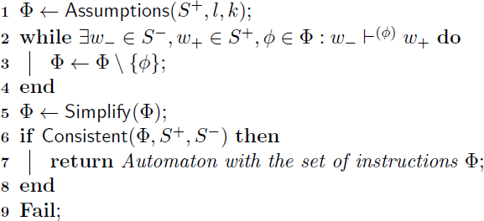
Learning Schema – Algorithm
Input:
Positive samples S⁺, negative samples S⁻, S⁺∩ S⁻ = ⍉, λ ∊ S⁺.
Upper limit l ≥ 1 on the width of instructions,
A specific length of contexts k ≥ 0.
Output:
Automaton M such that: L(M) ⊆ S⁺ and L(M) ∩ S⁻ = ⍉, or Fail.

Slide 15
Learning Schema – Step 1/4
Step 1:
We obtain some set of instruction candidates.
Note: We use only the positive samples to obtain the instructions.
Let us assume, for a moment, that this set 𝛷 already contains all instructions of the hidden target automaton.
Later we will show how to define the function Assumptions in such a way that the above assumption can be always satisfied.

Slide 16
Learning Schema – Step 2/4
Step 2:
We gradually remove all instructions that allow a single-step reduction from a negative sample to a positive sample.
Such instructions violate the so-called error-preserving property.
It is easy to see, that such instructions cannot be in our hidden target automaton.
Note: Here we use also the negative samples.

Slide 17
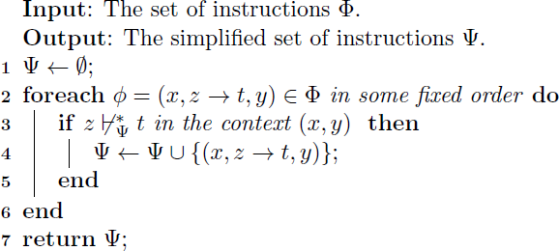
Learning Schema – Step 3/4
Step 3:
We remove the redundant instructions.
This step is optional and can be omitted – it does not affect the properties or the correctness of the Learning Schema.
Possible implementation:

Slide 18
Learning Schema – Step 4/4
Step 4:
We check the consistency of the remaining set of instructions with the given input set of positive and negative samples.
Concerning the identification in the limit, we can omit the consistency check – it does not affect the correctness of the Learning Schema. In the limit, we always get a correct solution.

Slide 19
Learning Schema – Complexity
Time complexity of the Algorithm depends on:
Time complexity of the function Assumptions,
Time complexity of the simplification,
Time complexity of the consistency check.
There are correct implementations of the function Assumptions that run in a polynomial time.
If the function Assumptions runs in a polynomial time (Step 1) then also the size of the set 𝛷 is polynomial and then also the cycle (Step 2) runs in a polynomial time.
It is an open problem, whether the simplification and the consistency check can be done in a polynomial time. Fortunately, we can omit these steps.

Slide 20
Learning Schema – Assumptions
We call the function Assumptions correct, if it is possible to obtain instructions of any hidden target automaton in the limit by using this function.
To be more precise:
For every k-cl-RA M (or k-scl-RA M ) with the maximal width of instructions bounded from above by l ≥ 1 there exists a finite set S₀⁺ ⊆ L(M) such that for every S⁺ ⊇ S₀⁺ the Assumptions(S⁺, l, k) contains all instructions of some automaton N equivalent to M.

Slide 21
Example – Assumptions_{weak}
Assumptions_{weak}(S⁺, l, k) := all instructions (x, z → t, y) :
The length of contexts is k :
x ∊ Σ ^{k} ∪ {¢}. Σ ^{≤ k - 1} (left context)
y ∊ Σ ^{k} ∪ Σ ^{≤ k - 1}.{$} (right context)
Our model is a Subword-Clearing Rest. Aut.:
z ∊ Σ⁺, t is a proper subword of z.
The width is bounded by l :
|xzty| ≤ l.
There are two words w₁ , w₂ ∊ S⁺ such that:
xzy is a subword of ¢ w₁ $,
xty is a subword of ¢ w₂ $.
This function is correct and runs in a polynomial time.

Slide 22
Example – Assumptions_{weak}

Slide 23
Example – Assumptions_{weak}

Slide 24
Example – Assumptions_{weak}

Slide 25
Example – Assumptions_{weak}

Slide 26
Example – Assumptions_{weak}

Slide 27
Part III: Active Learning Example
Our goal:
Infer a model of scl-RA recognizing the language of simplified arithmetical expressions over the alphabet Σ = {a, +, (, )}.
Correct arithmetical expressions:
a + (a + a) ,
(a + a) ,
((a)) , etc.
Incorrect arithmetical expressions:
a + ,
) a ,
(a + a , etc.
We fix maximal width l to 6, length of context k to 1.

Slide 28
Active Learning Example
Initial set of positive (S₁⁺) and negative (S₁⁻) samples.

Slide 29
Active Learning Example
Assumptions_{weak}(S₁⁺, l, k) gives us 64 instructions.
After filtering bad instructions and after simplification we get a consistent automaton M₁ with 21 instructions:

Slide 30
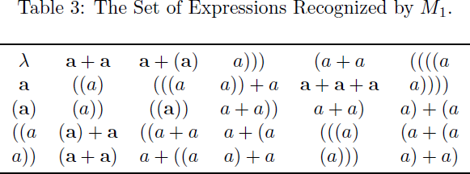
Active Learning Example
All expressions recognized by M₁ up to length 5 :
There are both correct and incorrect arithmetical expressions. Note that (a) + a was never seen before.
Next step: Add all incorrect arithmetical expressions to the set of negative samples. (We get: S₂⁺ = S₁⁺ and S₂⁻ ).

Slide 31
Active Learning Example
We get a consistent automaton M₂ with 16 instructions.
Up to length 5, the automaton M₂ recognizes only correct arithmetical expressions.
However, it recognizes also some incorrect arithmetical expressions beyond this length, e.g.:
((a + a) ,
(a + a)) ,
a + (a + a ,
a + a) + a .
Add also these incorrect arithmetical expressions to the set of negative samples. (We get: S₃⁺ = S₂⁺ and S₃⁻ ).

Slide 32
Active Learning Example
Now we get a consistent automaton M₃ with 12 instructions recognizing only correct expressions.
The automaton is not complete yet.
It does not recognize e.g. a + (a + (a)).
This time we would need to extend the positive samples.

Slide 33
Part III: Hardness Results
In general, the task of finding a consistent Clearing Rest. Aut. with the given set of positive and negative samples is NP-hard, provided that we impose an upper bound on the width of instructions.
This resembles a famous result of Gold who showed that the question of whether there is a finite automaton with at most n states consistent with a given list of input/output pairs is NP-complete.
Indeed, for every n-state finite automaton, there is an equivalent Clearing Restarting Automaton that has the width of instructions bounded from above by O(n).

Slide 34
Hardness Results
Let l ≥ 2 be a fixed integer. Consider the following task:
Input:
Set of positive samples S⁺,
Set of negative samples S⁻,
We assume that S⁺∩ S⁻ = ⍉, and λ ∊ S⁺.
Output:
0-cl-RA M such that:
The width of instructions of M is at most l.
L(M) ⊆ S⁺ and L(M) ∩ S⁻ = ⍉.
Theorem:
This task is NP-complete.

Slide 35
Hardness Results – Generalization
Let k ≥ 1 and l ≥ 4k + 4 be fixed integers. Consider:
Input:
Set of positive samples S⁺,
Set of negative samples S⁻,
We assume that S⁺∩ S⁻ = ⍉, and λ ∊ S⁺.
Output:
k-cl-RA M such that:
The width of instructions of M is at most l.
L(M) ⊆ S⁺ and L(M) ∩ S⁻ = ⍉.
Theorem:
This task is NP-complete for k = 1 and NP-hard for k > 1.

Slide 36
Part V: Concluding Remarks
We have shown that it is possible to infer any hidden target Clearing (Subword-Clearing) Rest. Aut. in the limit from positive and negative samples.
However, the task of finding a consistent Clearing Rest. Aut. with the given set of positive and negative samples is NP-hard, provided that we impose an upper bound on the width of instructions.
If we do not impose any upper bound on the maximal width of instructions, then the task is trivially decidable in a polynomial time for any k ≥ 0.

Slide 37
Open Problems
Do similar hardness results hold also for other (more powerful) models like Subword-Clearing Rest. Aut.?
What is the time complexity of the membership and equivalence queries for these models?

Slide 38
References
M. Beaudry, M. Holzer, G. Niemann, and F. Otto. Mcnaughton families of languages.
Theoretical Computer Science, 290(3):1581-1628, 2003.
Ronald V Book and Friedrich Otto. String-rewriting systems.
Springer-Verlag, New York, NY, USA, 1993.
Peter Černo. Clearing restarting automata and grammatical inference.
Technical Report 1/2012, Charles University, Faculty of Mathematics and Physics, Prague, 2012. URL http://popelka.ms.mff.cuni.cz/cerno/files/cerno_clra_and_gi.pdf.
Peter Černo and František Mráz. Clearing restarting automata.
Fundamenta Informaticae, 104(1):17-54, 2010.
C. de la Higuera. Grammatical Inference: Learning Automata and Grammars.
Cambridge University Press, New York, NY, USA, 2010.
R. Eyraud, C. de la Higuera, and J.-C. Janodet. Lars: A learning algorithm for rewriting systems.
Machine Learning, 66:7-31, 2007.
E. Mark Gold. Complexity of automaton identification from given data.
Information and Control, 37, 1978.
John E. Hopcroft and J. D. Ullman. Formal Languages and their Relation to Automata.
Addison-Wesley, Reading, 1969.
S. Lange, T. Zeugmann, and S. Zilles. Learning indexed families of recursive languages from positive data: A survey.
Theor. Comput. Sci., 397(1-3):194-232, May 2008.
R. McNaughton. Algebraic decision procedures for local testability.
Theory of Computing Systems, 8:60-76, 1974.
F. Otto. Restarting automata.
In Zoltán Ésik, Carlos Martín-Vide, and Victor Mitrana, editors, Recent Advances in Formal Languages and Applications, volume 25 of Studies in Computational Intelligence, pages 269-303. Springer, Berlin, 2006.
Y. Zalcstein. Locally testable languages.
J. Comput. Syst. Sci, 6(2):151-167, 1972.

Slide 39
Thank You!
The technical report is available on:
http://popelka.ms.mff.cuni.cz/cerno/files/cerno_clra_and_gi.pdf
This presentation is available on:
http://popelka.ms.mff.cuni.cz/cerno/files/cerno_clra_and_gi_presentation.pdf
An implementation of the algorithms can be found on:
http://code.google.com/p/clearing-restarting-automata/

